Slide 1
I’m going to Staten Island Children's Museum
for storytime!

Slide 2
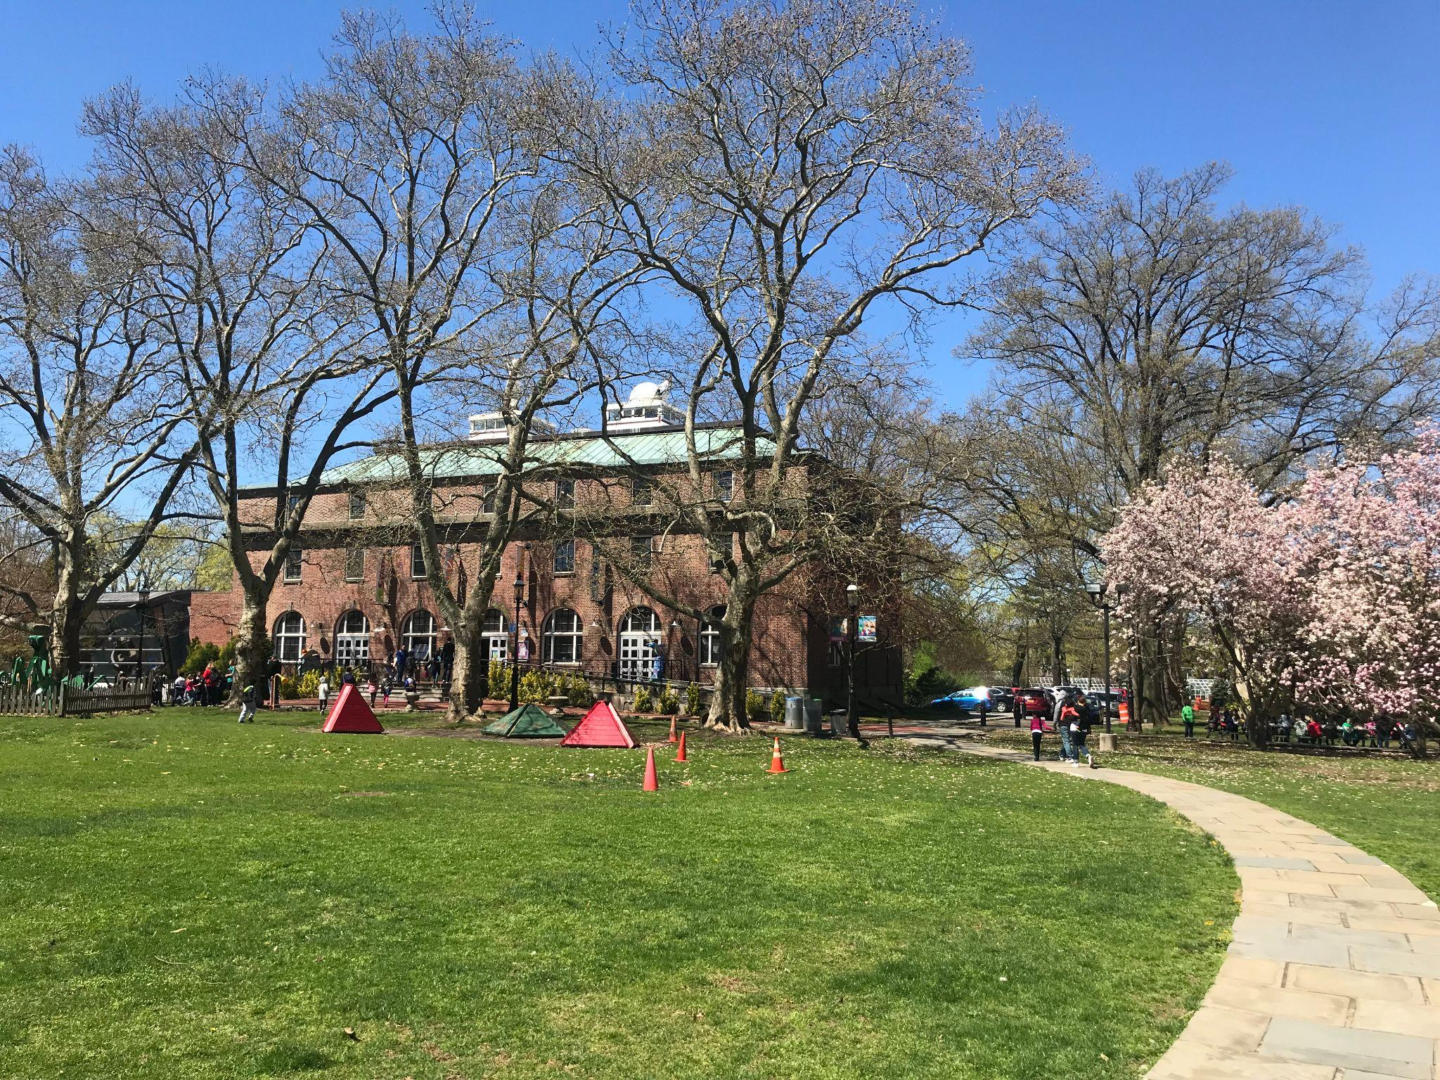
This is the Staten Island Children’s Museum

Slide 3
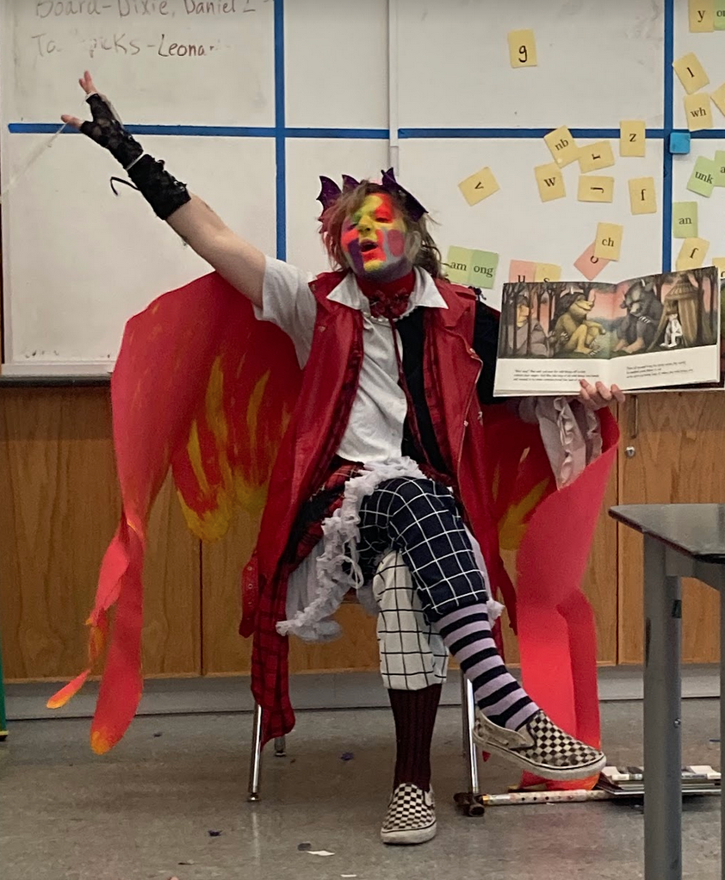
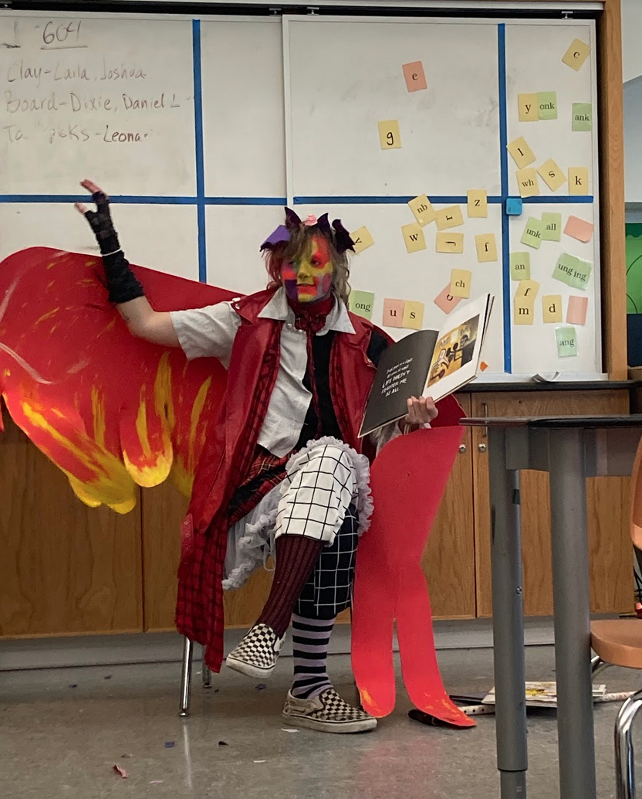
This is Professor Lionel Longlegs. They are a drag artist. They will read stories to me.

Slide 4
Lionel LOVES cars and trucks.
They will read 4 books about cars and trucks.

Slide 5
I will take a break to do a coloring activity.

Slide 6
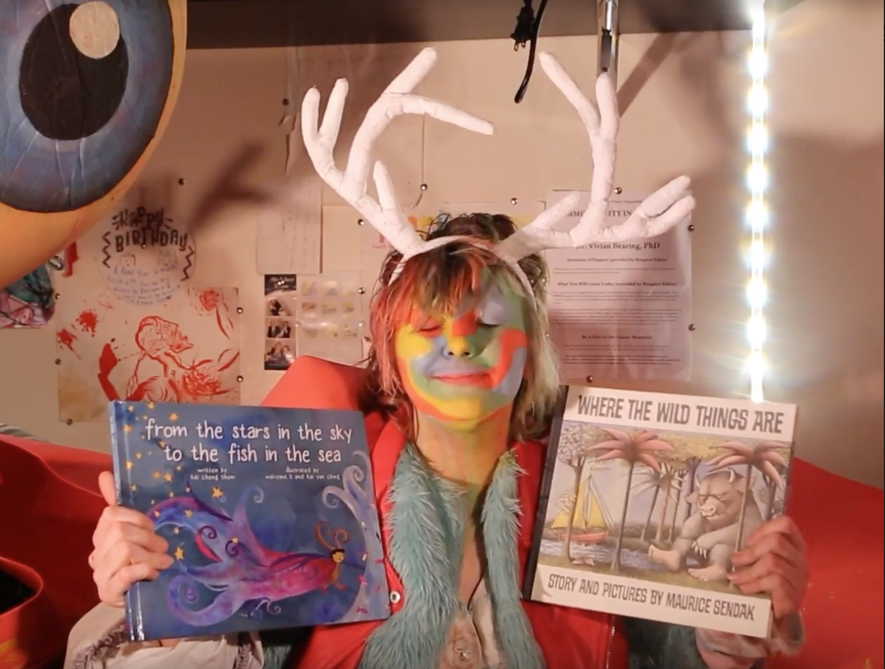
Angel Elektra says, “See you soon, friends. I can’t wait to read books about farm animals with you!
Lionel says “See you soon, friends! I can’t wait to read books about cars and trucks with you.”

